Slide 1
User A
User C
ORG 2
ORG 1
ORG 3
Belong to
ORG 4
User B
User D

Slide 2
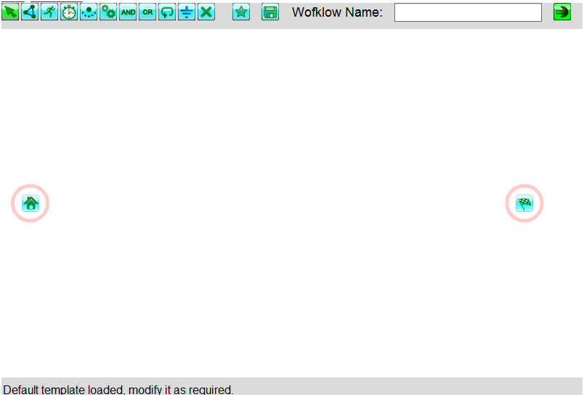
Toolbar
Design Area
Status Bar

